Slide 1
GLOBAL STUDENT MOBILITY INSIGHTS AND TRENDS
A DETAIED ANALYSIS OF STUDENTS GOING ABROAD HIGHER STUDIES ACROSS DIFFERENT

Slide 2
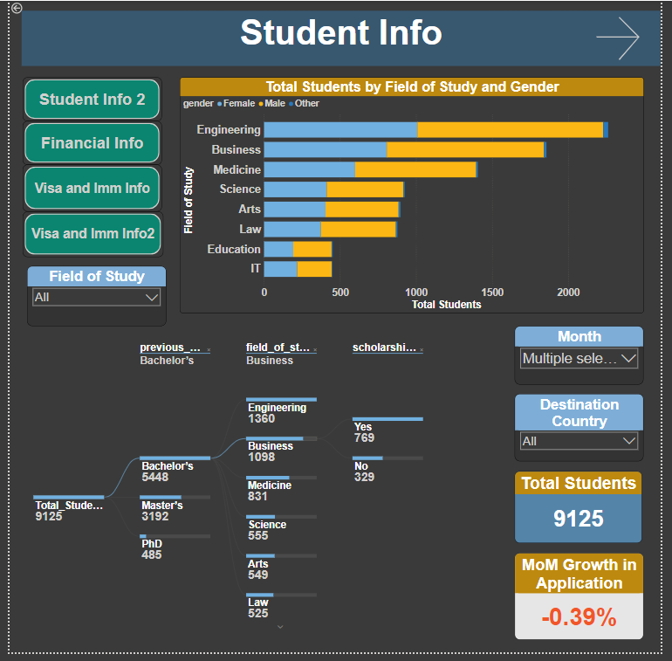
This Chart Represents the total Students based on Field of study they took Admission in and their gender
These are the buttons which helps to navigate to respective dashboards
This Chart Represents The Student Distribution of Students by Previous Study, Field of Study, Scholarship Received
This Card Contains info about Month on Month Change in No. of Applications

Slide 3
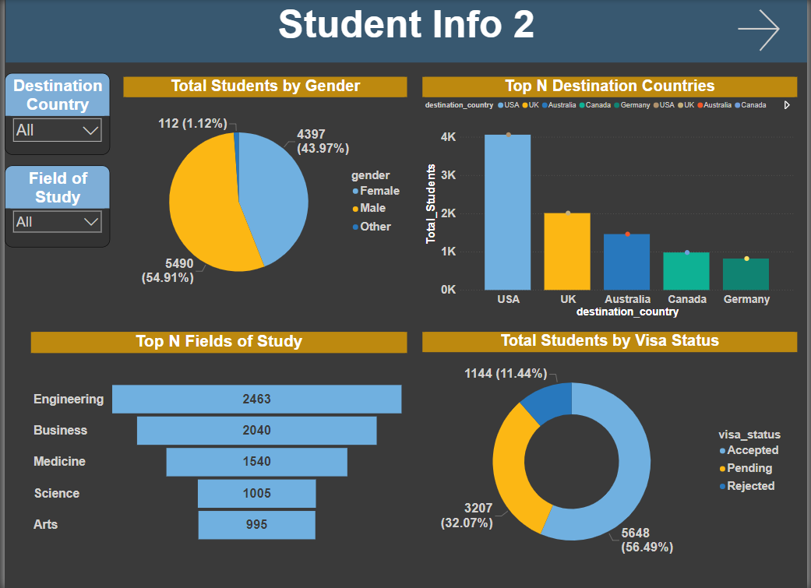
Distribution of total students according to the gender
This is a dynamic bar chart which represents top n destination countries as per total number of students
Top N majors chosen for their degree
A pie chart that represents distribution of total students wrt the visa status

Slide 4
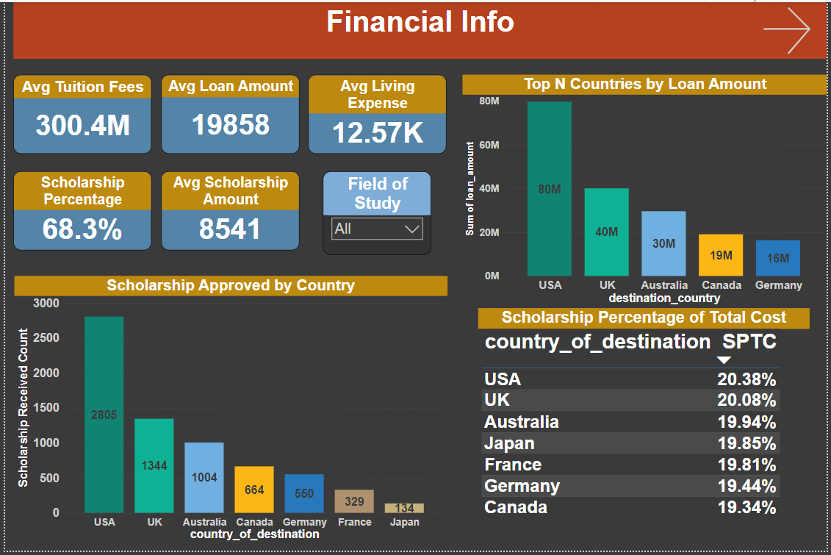
This bar chart represents the total loan amount taken by students to study in various countries
These card show information about avg tuition fee, loan amount, living exp, percentage of students receiving scholarship and scholarship amount
This table shows the percentage of scholarship wrt to total cost which includes tuition fee, living expenses.
This bar chart represents number of scholarships approved by different countries

Slide 5
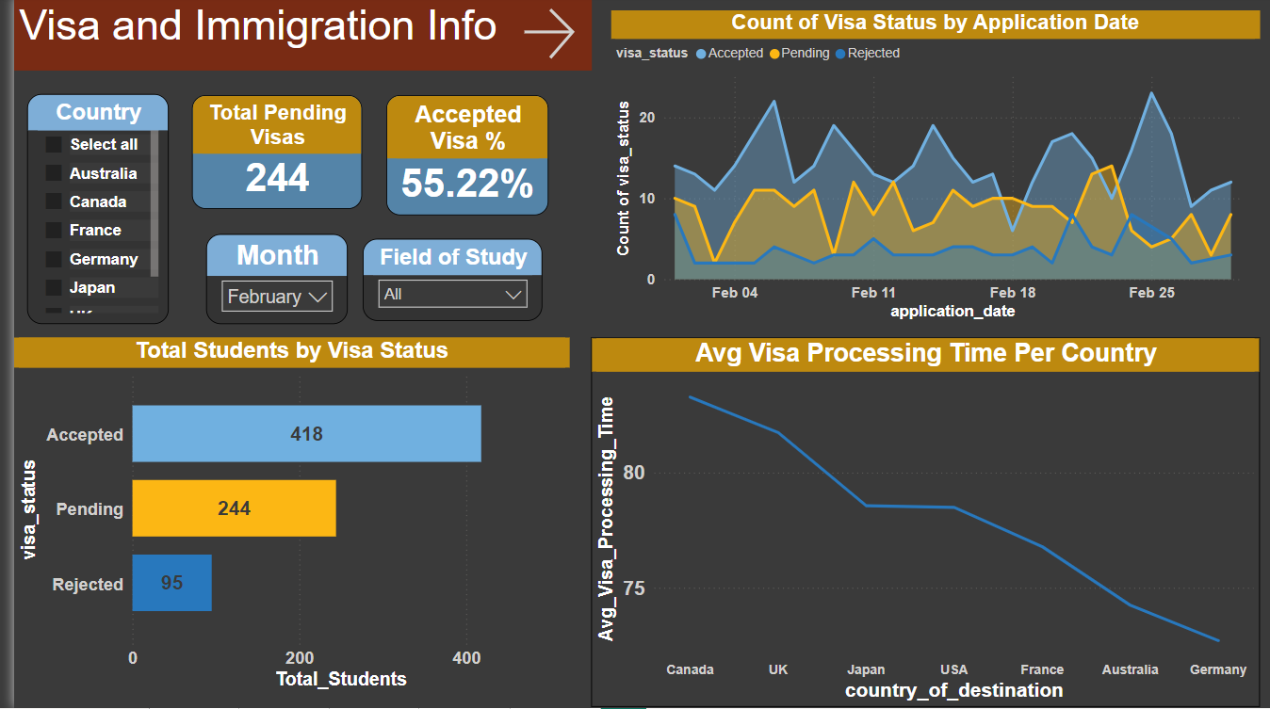
These Card represents the Total Pending Visas and Percentage of Visa Accepted Per Country
This Chart Represents Count of Accepted,
Pending and Rejected Visas Per day of a Month
This line chart represents average time it takes for visa approvals across different countries
This bar chart represents total students as per their visa status

Slide 6
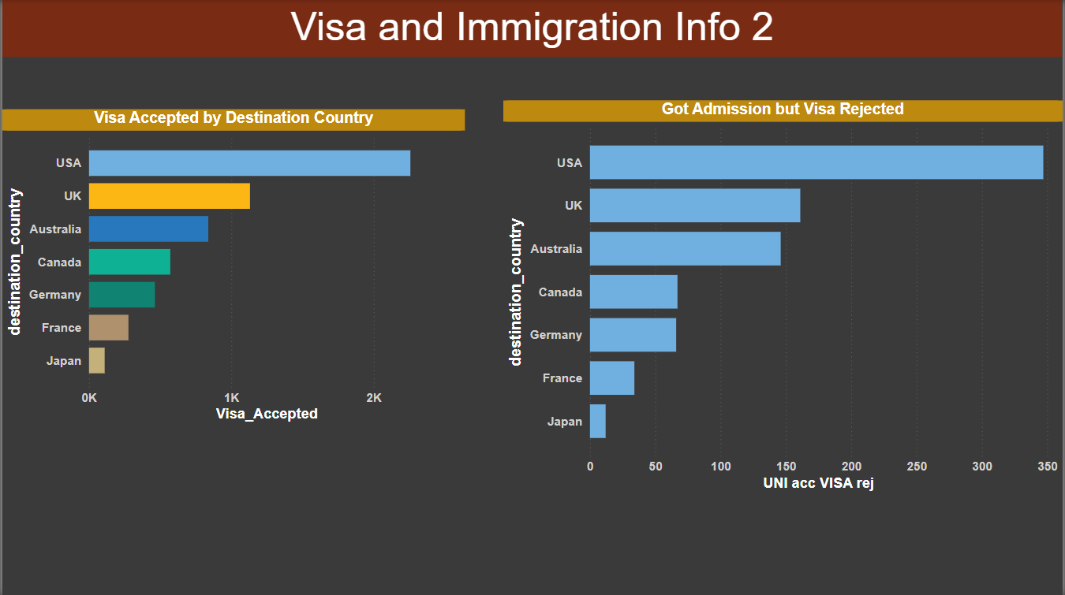
This bar chart represents number of visas accepted by each destination country
This bar chart represents number of students who got admission but had their visas rejected

Slide 7
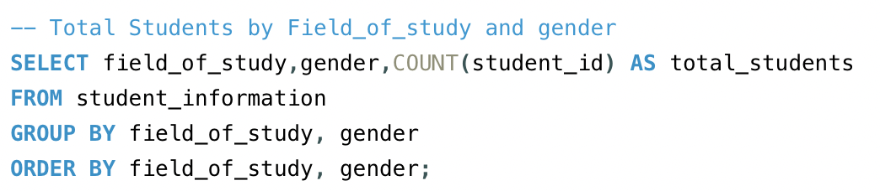
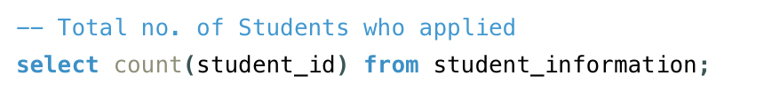
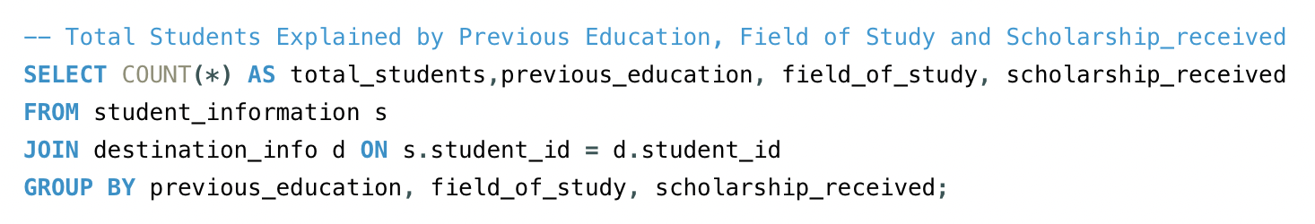
Most Students are in Business and Engineering
- Females pursue Arts and Education
Count = 9999
Top Degree with Most Applications: Bachelors
Top Field with Most Applications: Engineering
Total Visa Approved: 6879
Total Visa Not Approved: 3119

Slide 8
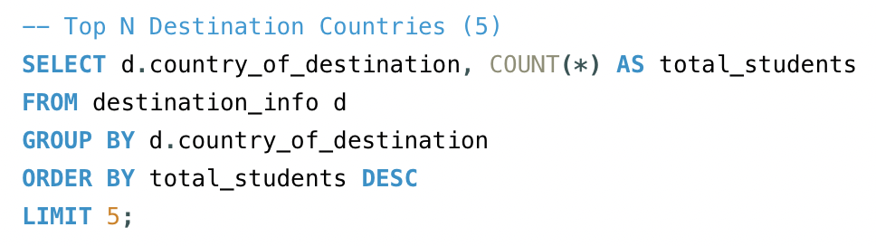
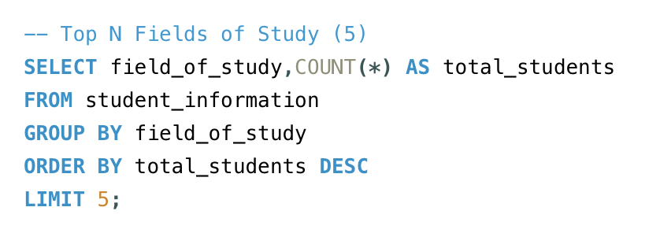
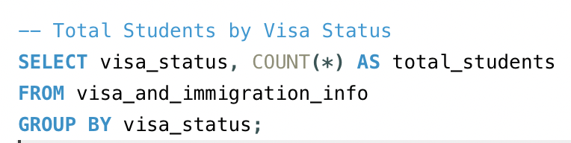
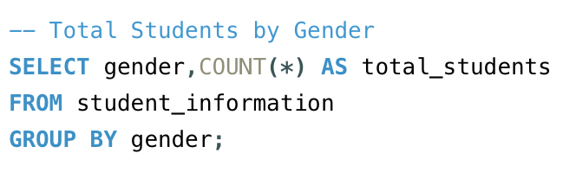
TOP DESTINATION COUNTRIES
USA
UK
AUSTRALIA
CANADA
GERMANY
TOP FIELDS OF STUDY
ENGINEERING
BUSINESS
MEDICINE
SCIENCE
ARTS
ACCEPTED : 5648
PENDING : 3207
REJECTED : 1144
FEMALE : 4397
MALE : 5490
OTHER : 112

Slide 9
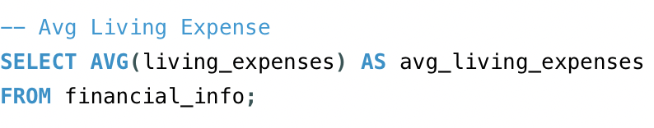
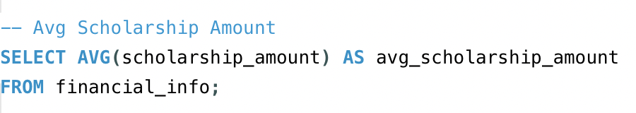
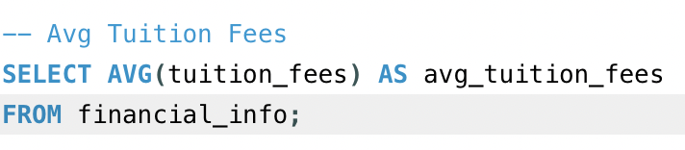
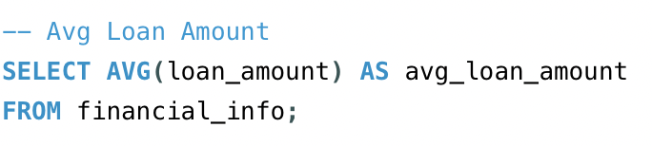
12569
8551
30052
19857

Slide 10
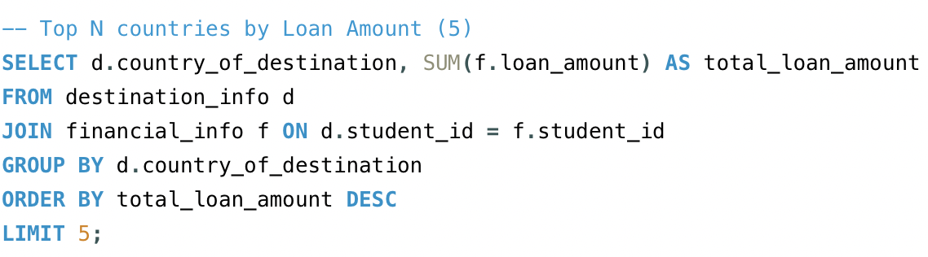
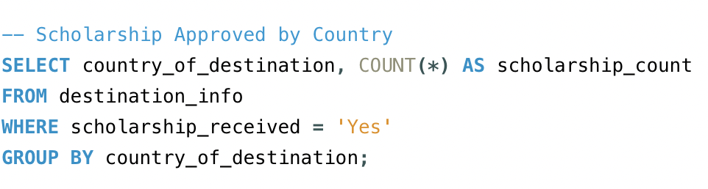
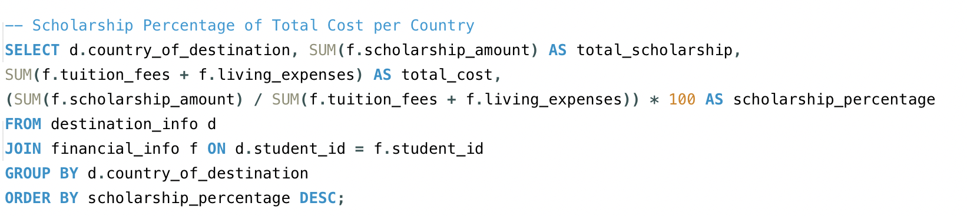
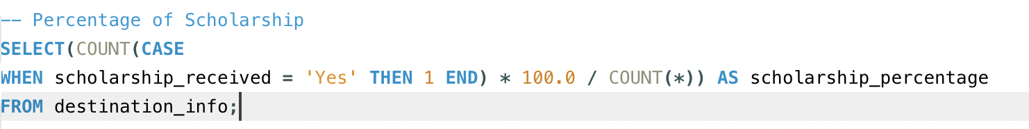
USA : 2805
UK : 1344
AUSTRALIA : 1004
CANADA : 664
USA and UK offer the most loans
USA : 20.4%
UK: 20.1%
AUSTRALIA: 19%
68.3%

Slide 11

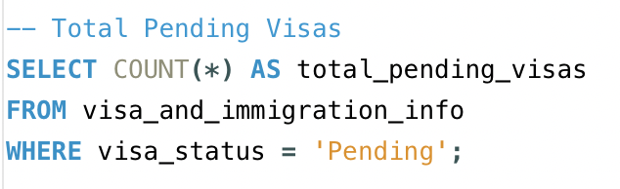
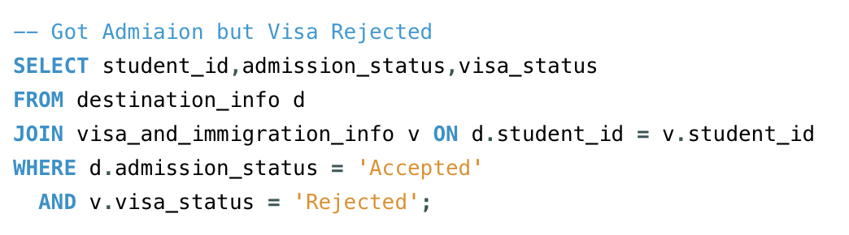
JAPAN: 95 DAYS
FRANCE: 93 DAYS
UK: 93 DAYS
GERMANY: 91 DAYS
2207
56.48%
USA: 347
UK: 161
AUSTRALIA: 146
CANADA: 67

